Slide 1
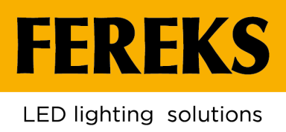
ABOUT COMPANY, PRODUCTION AND
RELEASED PRODUCTS
GOOD LIGHT IS AVAILABLE TO EVERYONE

Slide 2
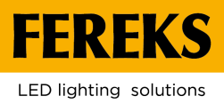
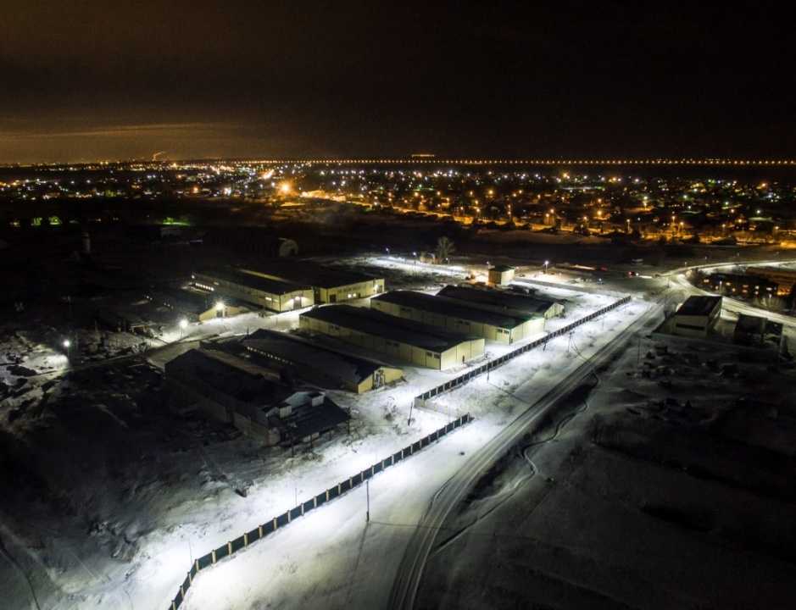
PRODUCTION FACTS
«Trading house «FEREKS» LLC is one of the biggest russian manufacturers of LED luminaires.
Serial production of LED-luminaires since 2010
More than 100 modifications of LED luminaires of different designation
50 000 luminaires monthly
More than 300 employees
2 design and engineering departments
20 000 m² total area of 2 production sites
More than 80% level of production localization
2

Slide 3
FEREKS PRODUCTION IS:
Quality warrant
All “Fereks” products undergo quality control, have an individual number, Russian and international certificates.
ISO 9001–2011
The company's quality management system meets the requirements of the international standard GOST ISO 9001–2011
High level of production automation
Two sites of the factory are equipped with modern high-precision equipment and automatic lines.
Own lighting laboratory and two design and engineering departments.
Our own laboratory allows measuring the light distribution forces of all manufactured products and generate ies-files for them.
Manufacturing flexibility
We develop and produce luminaires for individual order in a short time
Fast shipment
Warehouse program in the territory of the Russian Federation, the CIS, and Europe
3

Slide 4
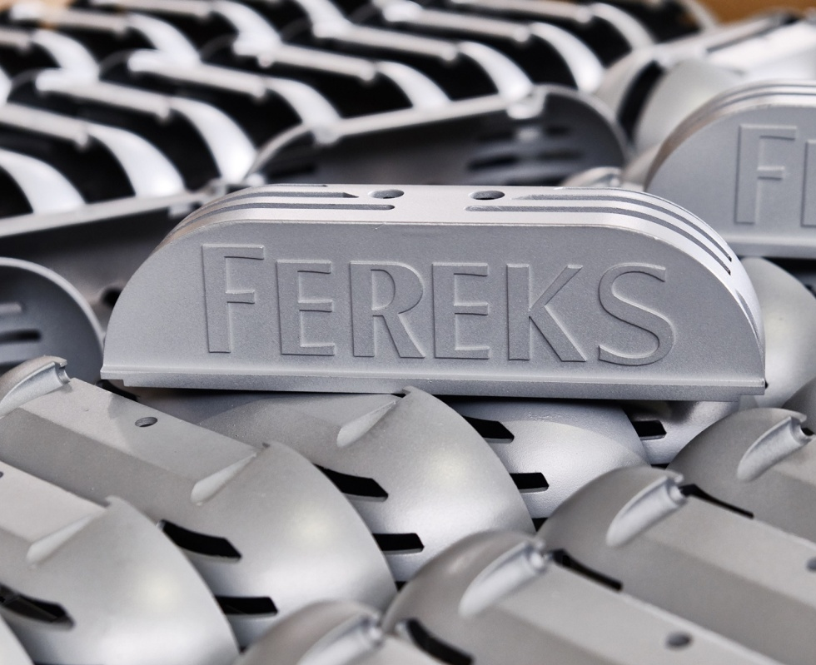
RANGE OF MANUFACTURED GOODS
THE COMPANY'S CAPACITIES ALLOW PRODUCOING OVER 50,000 PRODUCT UNITS PER MONTH.
The range of the company includes more than 100 models of LED luminaires and over 1000 modifications.
More than 5,000,000 LED luminaires have been produced during 10 years of work .
4

Slide 5
FEREKS PRODUCTION CHAIN
All stages of LED lighting production are carried out at two “FEREKS” production sites:
1
2
3
Cutting of sheet material (ODP, fiber-optic laser, waterjet cutting machine).
Foundry
Bending and welding area.
CNC machining and turning-milling centers.
Workshop of preparing products
for painting. Two-operator
painting line.
6
5
4
2 automatic lines for mounting SMD components.
Lighting laboratory with a goniophotometer.
Prismatic Acrylic Extrusion Line.
Injection molding machines (manufacture of optics).
Spanish automated line for the production of SSV LED luminaires (office).
7
8
9
Workshops for assembling LED luminaires (street, industrial, commercial).
100% inspection of luminaires by the technical control department and a section for running of the luminaires in three types of voltage.
Workshops for packaging and shipment of products.
5

Slide 6
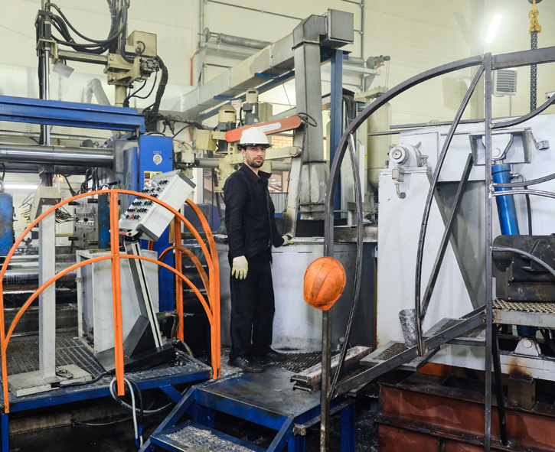
CASTING AND MILLING WORKSHOPS
The foundry section at the “FEREKS” factory was one of the first in the Republic of Tatarstan equipped with modern robotic foundry equipment. Installed 4 automatic aluminum die casting machines with a locking force of 160 tons, 400 tons and two machines of 900 tons each.
All aluminum components are being cast on them: covers and housings for luminaires.
Productivity: 2500 pcs / shift. The machines work fully automatically according to a given program.
The milling workshop provides finishing for some of the moulding parts. The machines work fully automatically according to a given program. One or two operators are enough for control and maintenance.
6

Slide 7
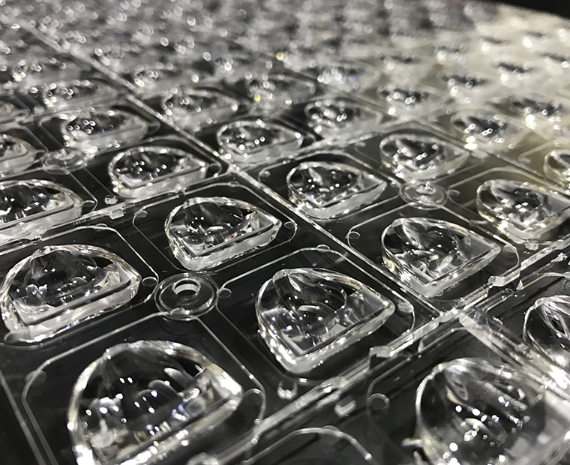
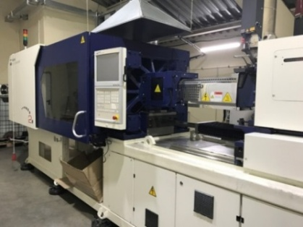
OWN SECONDARY OPTICS
LUMINAIREs "FEREKS" ARE equipped with secondary optics, manufactured directly IN our production.
You can choose from optics with a light distribution curve of the type “D", "D", “C", "W", as well as special (25 ° x100 °).
It is possible to create optics taking into account individual tasks.
Secondary optics manufacturing machine.
7

Slide 8
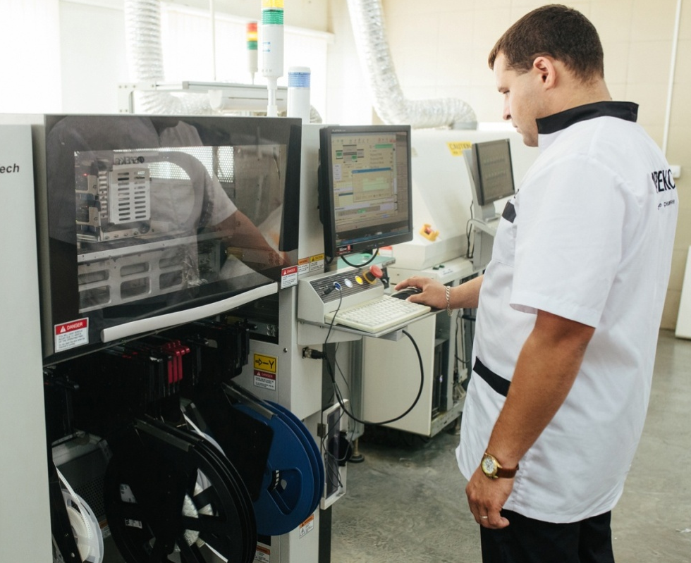
OWN AUTOMATIC SMD-MOUNTING LINE
SMD TECHNOLOGY APPLIES FOR SURFACE MOUNTING OF BOARDS. SMD LINE INCLUDES 6 STEPS.
There are two SMD lines for surface mounting of SMD components on boards at the production sites of "FEREKS”.⠀ ⠀
Productivity of the SMD line at the “FEREKS” site in Laishevo: 16,000 diodes/hour.
Productivity of the SMD line at the “FEREKS” site in Laishevo village: 40,000 diodes / hour.
8

Slide 9
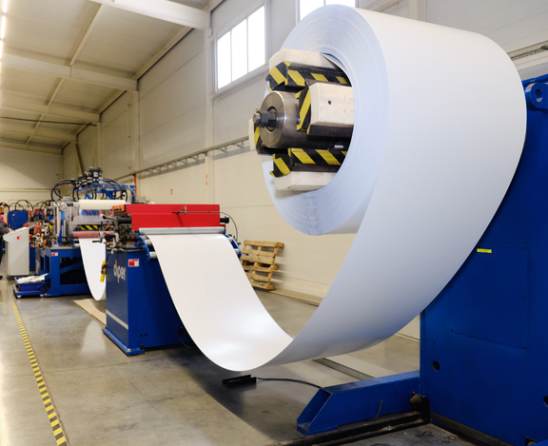
OWN AUTOMATIC LINE DIPER
The Spanish automatic line Diper has no analogues in the world and was developed by the order of FEREKS. ⠀
Thanks to the automated production process and the use of rolled metal, the costs of components are optimized and the amount of waste is minimal. High productivity and quality of workmanship are ensured.
The line capacity is more than 2 million housings per year.
9

Slide 10
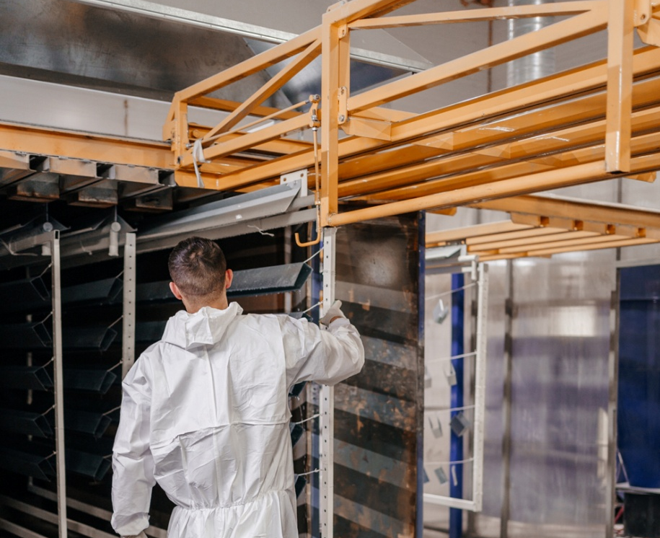
SURFACE PREPARATION AND PAINTING OF PRODUCTS LINE
The line includes following stages:
— Washing products with an anti-corrosion and disinfecting agent, washing with demineralized water.
— Drying.
— Powder coating (any color from the RAL catalog).
— Oven polymerization .
The result: a high-quality, even and durable coating of FEREKS luminaires.
10

Slide 11
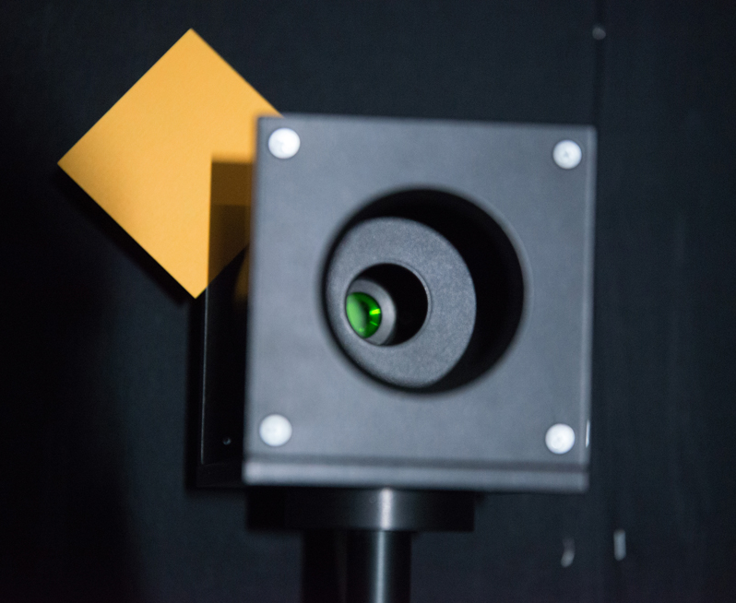
OWN LIGHTING LABORATORY
a lighting laboratory, which includes a goniophotometer, has been organized For accurate measurement of the light distribution strength ON THE FEREKS SITE IN STOLBISHCHE.
We have a high-precision goniophotometric installation. The error in measuring the value of the luminous intensity does not exceed 3%. The installation can be used both for measuring large-sized lighting devices, and individual LEDs, researching the parameters of any optical elements, diffusers, group optics.
11

Slide 12
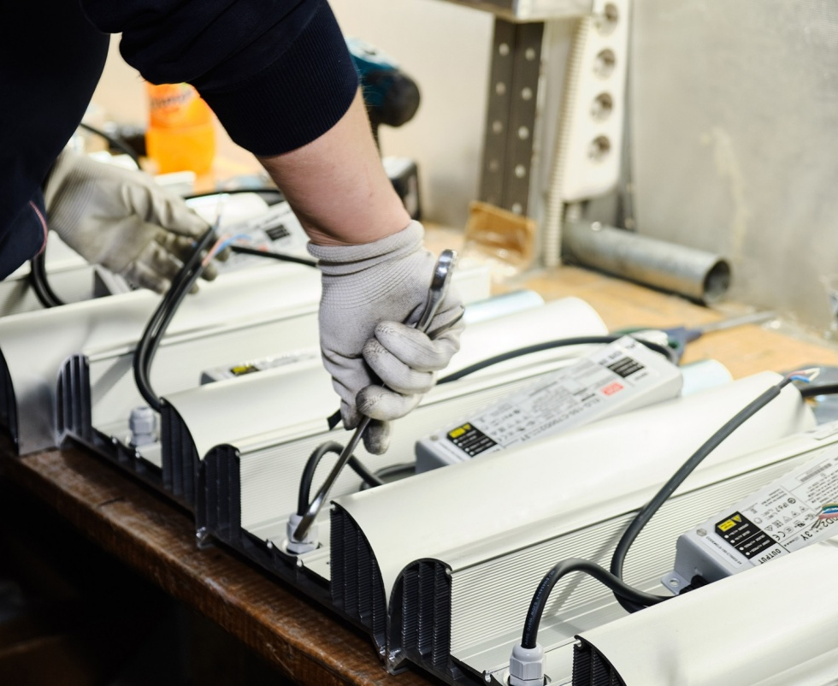
ULTRA RELIABLE MEAN WELL POWER SUPPLIES
“FEREKS” LUMINAIRES ARE COMPLETED WITH DRIVERS FROM THE LEADING WORLD MANUFACTURER - MEAN WELL
In appretiation of the long-term and fruitful cooperation, MEAN WELL has identified Trading House “FEREKS” LLC as its global partner in Russia in the “Powered by MEAN WELL” project.
«Partners who join the “Powered by MEAN WELL” project are eligible for a global warranty service and a draft pricing strategy. It is written in the official MEAN WELL certificate for FEREKS, signed by MEAN WELL CEO and President - Jerry Lin
12

Slide 13
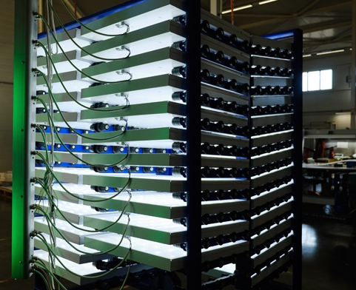
QUALITY IS HIGHER THAN PRICE
«FEREKS» products are being tested
both in our own and in independent laboratories: VNISI named after Vavilov or “Archilight” laboratory.
All FEREKS LED luminaires are tested at the factory before shipment. The run cycle is 3 hours of continuous operation of the product. ⠀ A special sticker is glued to each luminaire, in the product’s passport and on the packaging, for quality control and identification. ⠀
13

Slide 14
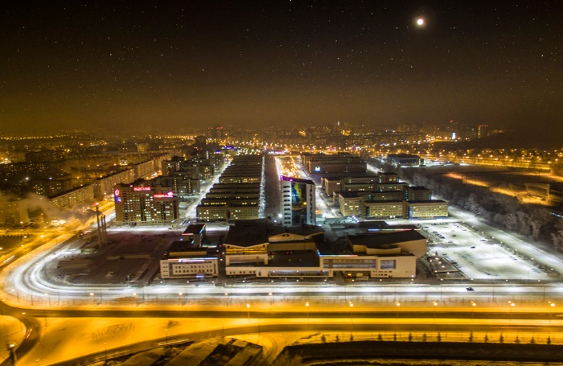
FOCUS ON ENERGY EFFICIENCY
Nowadays, energy conservation and transition to energy efficient lighting is a national challenge*.
170 Lm/W
Luminous efficiency of new models of LED luminaires of the FLA series
201 Lm/W
The luminous efficiency of the new FHB series LED luminaires is the highest in the world
*Federal Law of 23.11.2009 N261-FZ.
The standards for the luminous efficacy indicator are listed in the Decree of the Government of the Russian Federation of 03.11.2018 N 1312 "On amendments to the requirements for lighting devices and electric lamps, used in alternating current circuits for lighting purposes“. Resolution of the Government of the Russian Federation No. 971: "By 2020, organizations must replace 75% of luminaires with LEDs."
14

Slide 15
ADVANTAGES OF CONSOLE LUMINAIRES
Work in a wide range of power supplies
Power supplies with a wide range of power supply
from 90-130AC, 100-300AC
High color rendering index
Ra not less than 80
High energy efficiency
Average luminous efficacy 140 Lm / W
Smart lighting
Dimming, remote control
Wide possibilities of operation
Weather resistance,
UV resistance, high hardness.
Operating temperature:
-40 ÷ + 50 ° С / -60 ÷ + 50 ° С.
Ease of use
Quick installation,
the ability to replace drivers
Own production
From plugs to housing and optics;
quality control at all stages of production
Honest parameters
Compliance of the declared
characteristics with the real ones
15

Slide 16
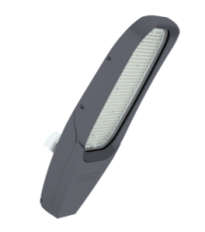
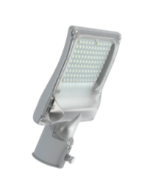
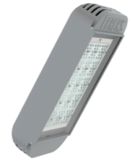
STREET LIGHTING
SERIE FLA
50-150 W
High energy efficiency
The luminous efficacy index on average for the series exceeds 140 lumens per watt
New level of illumination
Special optics create uniform illumination of the roadway without dark spots
Possibilty of driver change
Access to the driver allows to replace it without disconnecting the luminaire from the power supply
Dimming and remote control
For most of the modifications, dimming of the luminaire and compatibility with remote control systems are available
SERIE FLS
35 W
SERIE DKU
68-260 W
LED luminaires "FEREKS" for illumination of streets, roads, square lighting, illumination of adjoining territories and other
objects are presented in the following series: FLA, FLS, FSL, DKU
16

Slide 17
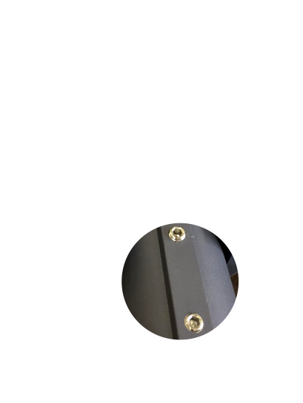
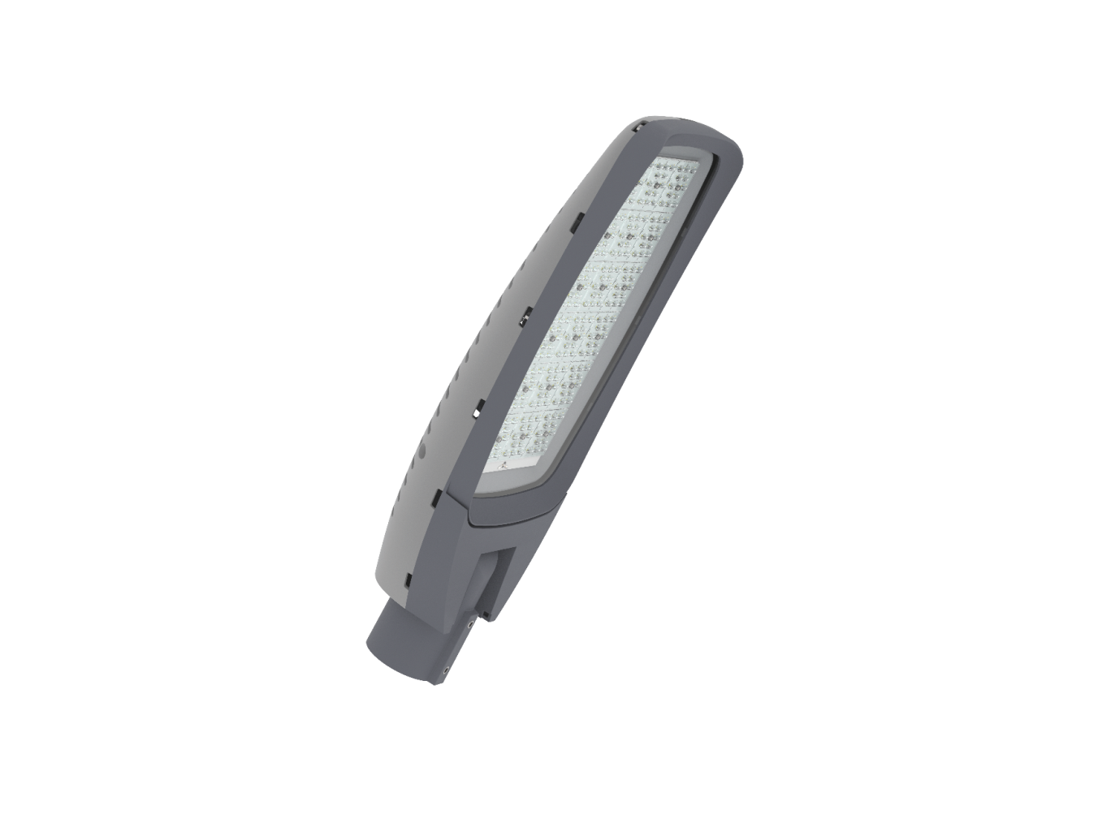
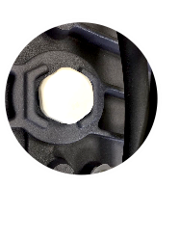
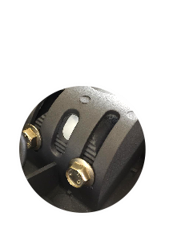
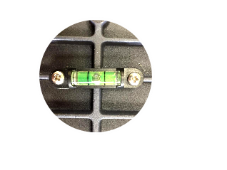
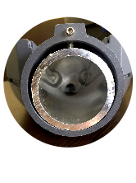
CONSOLE LUMINAIRES SPECIALITIES
FLA 13A-80-850-WL
Pressure equalization valve to prevent
moisture from entering
the luminaire and causing condensation
Captive fasteners on the housing
will not be lost
when the cover is removed
Possibility to adjust the angle of inclination
of the luminaire within 30 degrees
Bubble level
for easy installation
Console mounting
on pipe ∅ 48 or 60 mm (adapter)
17

Slide 18
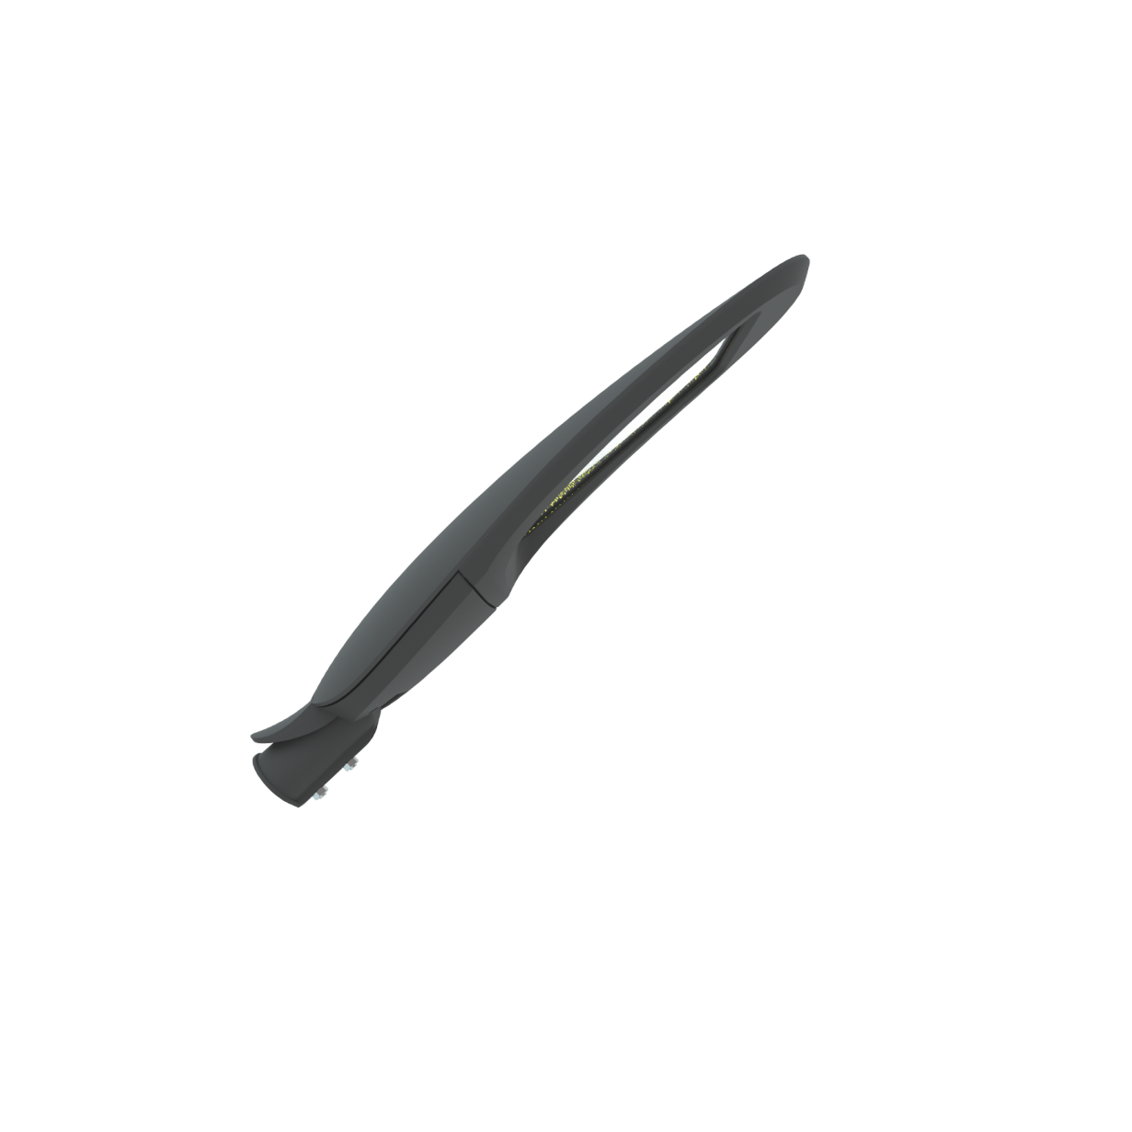
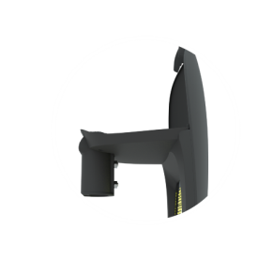
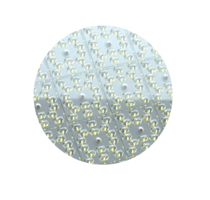
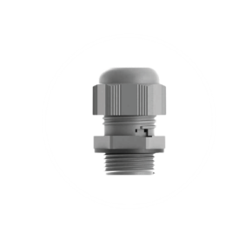
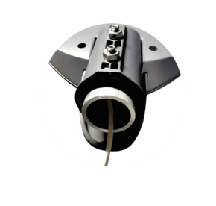
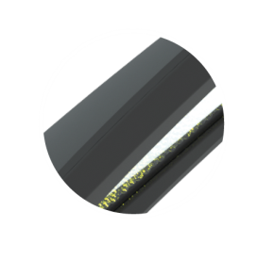
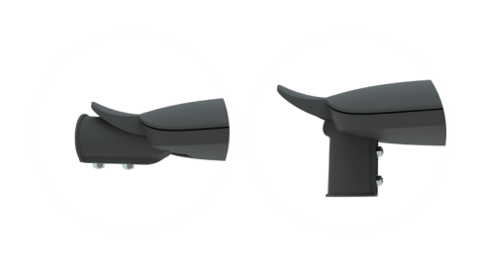
CONSOLE LUMINAIRES SPECIALITIES
FLA 04A-220-740-WA
The product was designed
by Italian industrial
designers
Access to the driver, ability
to replace it without disconnecting
the luminaire from the power supply
High luminous efficiency
150 Lm / W
Sealed lead-in with
a pressure equalization valve
prevents moisture from entering the luminaire
Console mounting
on pipe ∅ 48 or 60 mm
(2 swivel-brackets)
Tear-drop body reduces
the likelihood of sediment accumulation
Two positions of installation of the luminaire
relative to the support: 0 and 90 degrees
18

Slide 19
EXAMPLES OF ADJUSTMENT OF FLA LUMINAIRES
FLA 04A
FLA 03A, 28A, 46A, 13A, 130A
19

Slide 20
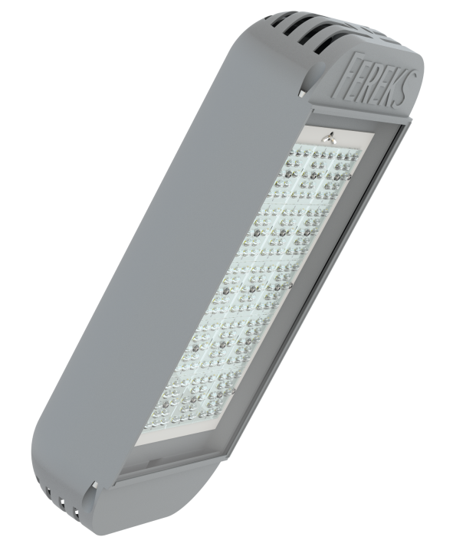
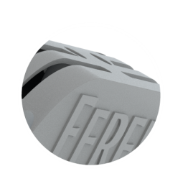
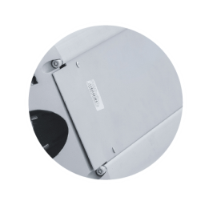
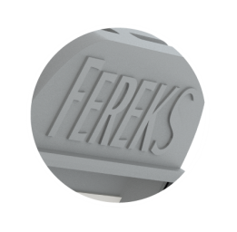
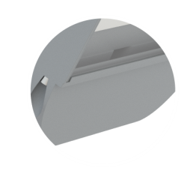
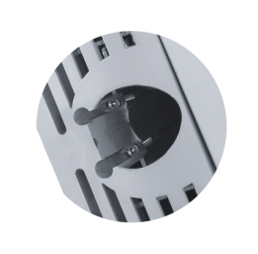
CONSOLE LUMINAIRES SPECIALITIES
DKU
A sealed lead-in with a valve prevents
moisture from entering the luminaire
Removable cover for driver
replacement (on demand)
Time-tested - no breakdowns within
100 months of operation
Aluminum plugs
for improved heat dissipation
Various mounting options
20

Slide 21
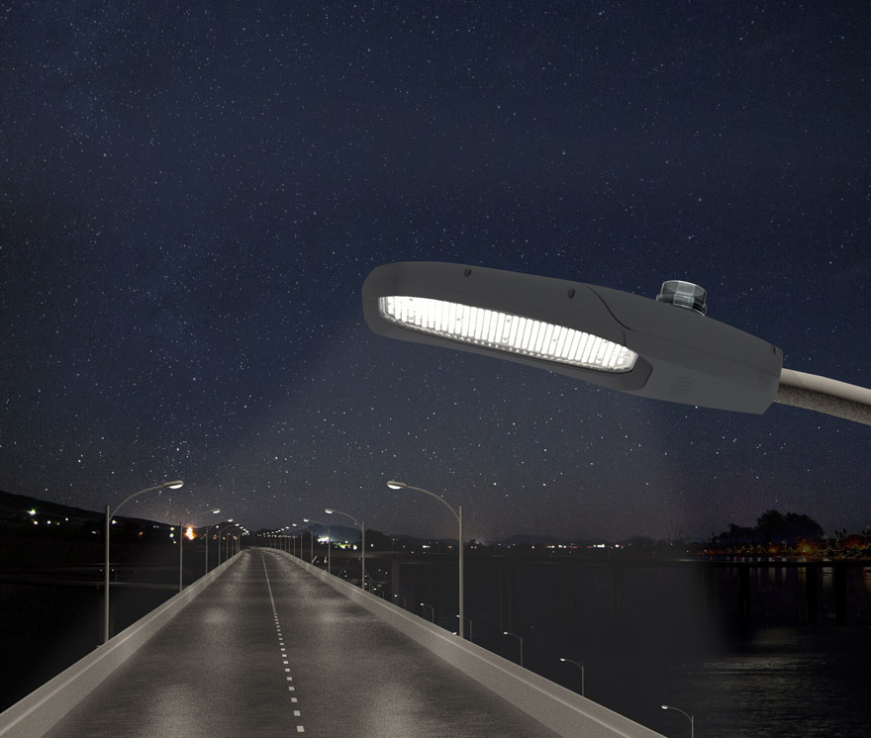
FOCUS ON "SMART" LIGHT
DALI
Compatible with remote control systems (including DALI protocol)
DIMM
Adjusting the brightness of the luminaire in automatic or manual mode
21

Slide 22
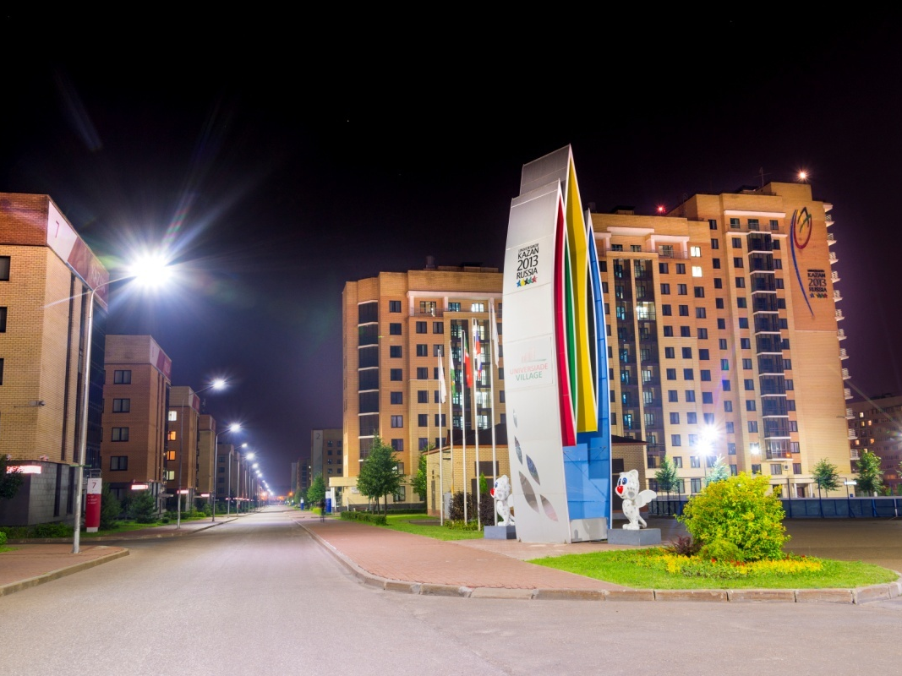
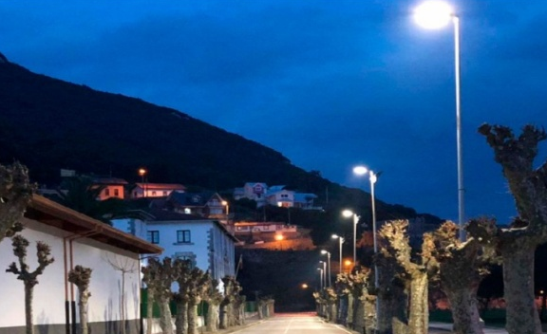
ILLUMINATION PROJECTS
with LED console luminaires of the FLA, FSL and DKU series
Quay in Santoya (Spain)
Universiade village (Kazan)
«Leroy Merlin» parking
22

Slide 23
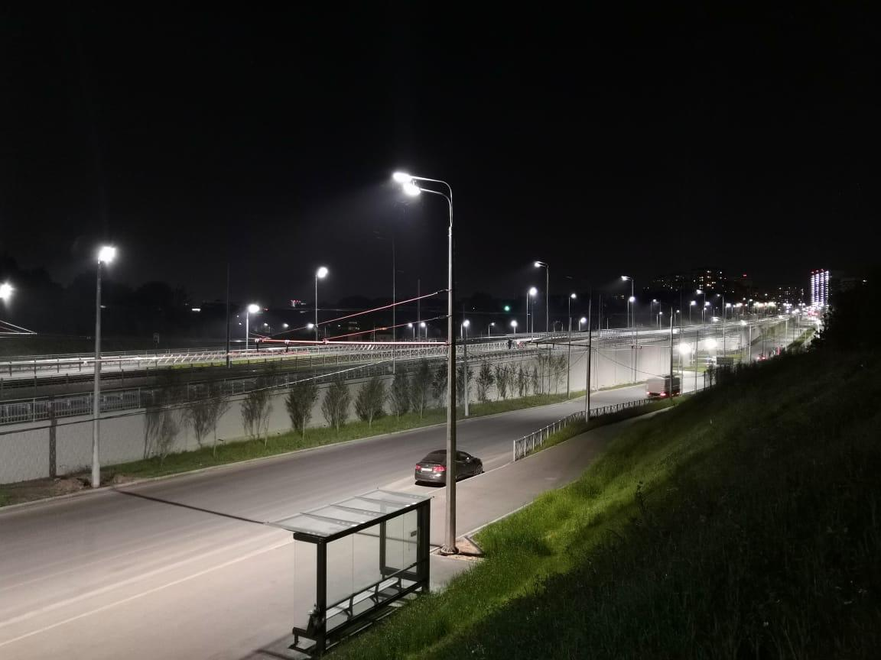
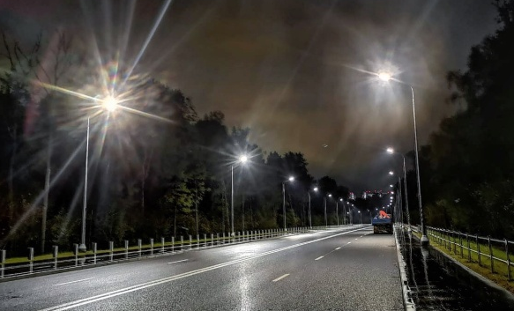
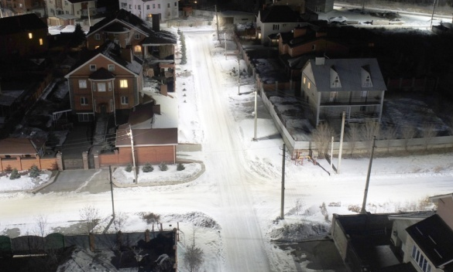
ILLUMINATION PROJECTS
with LED console luminaires of the FLA, FSL and DKU series
Vnukovskoye highway
Big Kazan traffic circle
Street lighting in Magnitogorsk
23

Slide 24
ADVANTAGES OF “FEREKS” PUBLIC LIGHTING LUMINAIRES
High energy efficiency
Average luminous efficacy 140 lm / W
Increased efficiency
Flicker and ripple free
Replacement of traditional luminaires
such as LPO, LSP in “Armstrong” ceilings
High color rendering index
Ra not less than 80
Universal installation
Integrated or surface-mounted
installation method.
Trunk connection of linear models
Quality and guarantees
Quality control at all stages of production.
Factory warranty - 5 years
Own production
From plugs
to housing and optics
Honest parameters
Compliance of the declared characteristics
with the real ones
24

Slide 25
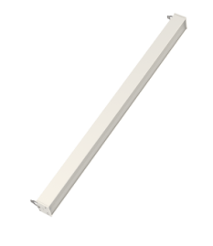
ADVANTAGES OF “FEREKS” PUBLIC LUMINAIRES
SERIE FDL
43-130 W
«Trunk» installation
Possibility of luminaire connection in a single light line
Comfortable light
Natural color rendition, no flicker, crackle-free operation create the most comfortable atmosphere
Efficient energy consumtion
Saving energy, reducing the cost of the air conditioning system (LED luminaires do not generate heat and do not heat the room)
Gentle lighting
No harmful UV and infrared radiation, safe lighting
SERIE SSV
15-56 W
SERIE DVO
18-56 W
25

Slide 26
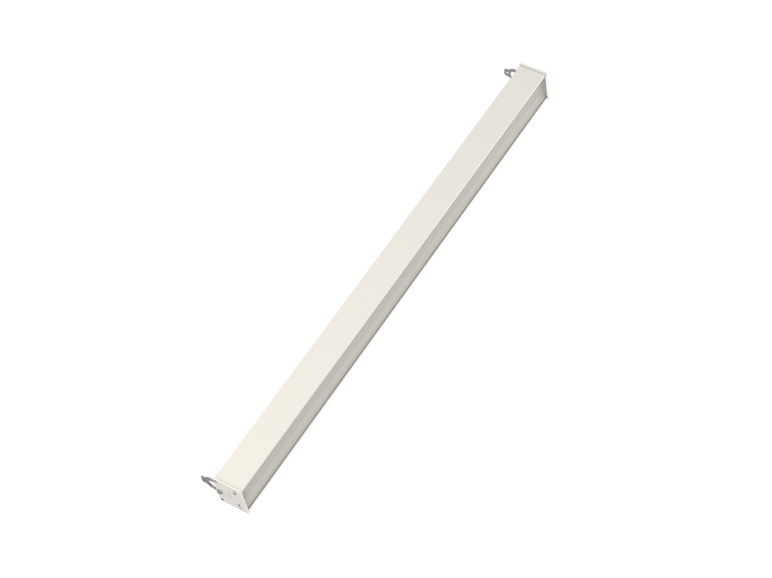
LINEAR LUMINAIRES SPECIALITIES
FDL
Aluminum alloy housing
Diffuser made of
impact-resistant opal polycarbonate
Uniform glow
without dazzle effect
Various diffuser
options are available
Possibility of execution
with IP20 or IP54
Wide installation possibilities: suspended,
surface-mounted (wall, ceiling),
in line (special version)
26

Slide 27
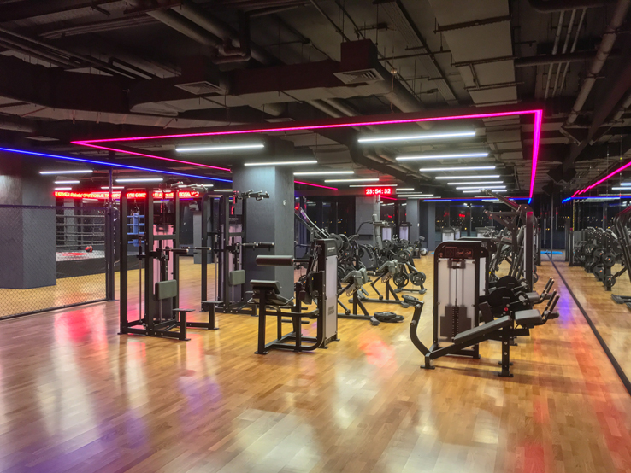
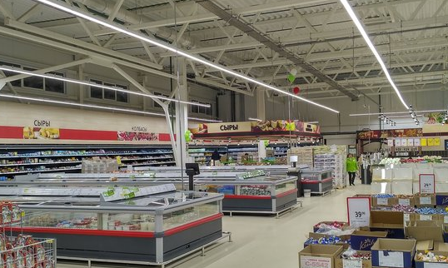
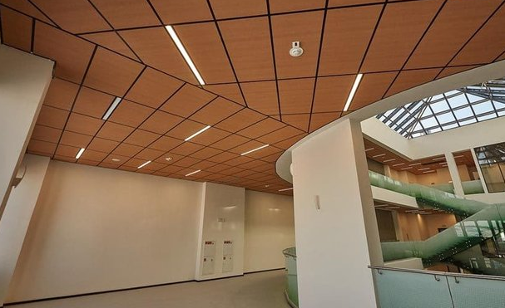
ILLUMINATION PROJECTS
with LED luminaires of the FDL series
Hypermarket «Essen»
Fitness club RAKETA
University of Innopolis
27

Slide 28
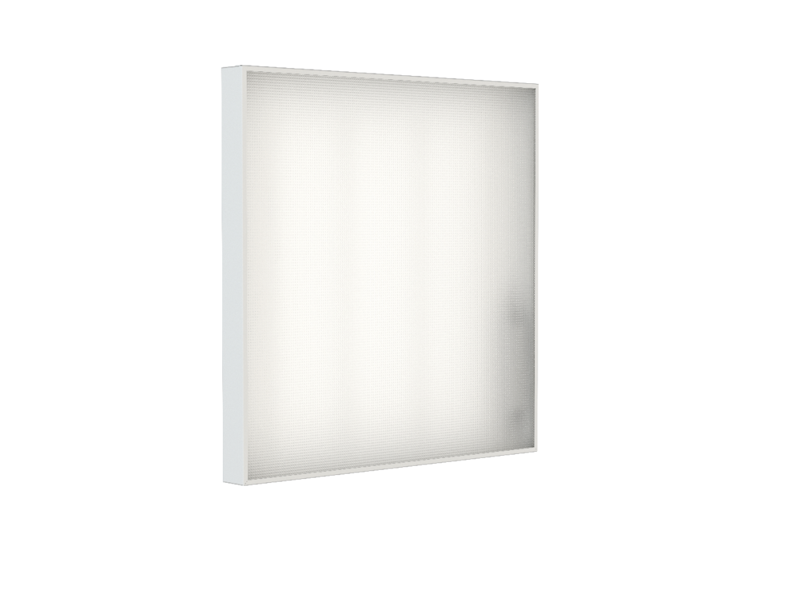
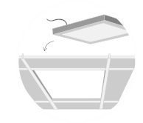
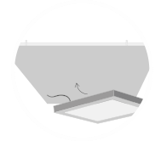
OFFICE LUMINAIRES SPECIALITIES
SSV
Robust metallic housing
Durable prismatic polystyrene
with high light transmittance
Diffuser will not change
color over time
Universal installation:
surface-mounted or integrated
28

Slide 29
ILLUMINATED OBJECTS
with LED luminaires of the SSV series
School of Arts "Nutcracker"
Business- center
Supermarket
29

Slide 30
INTEGRATED LUMINAIRES OF DOWNLIGHT TYPE
DVO
Secure mounting with clamps
Housing of Downlight type
of mounded aluminum
Possibility of production with IP20 or IP65
(for wet rooms or outdoor installation
under a canopy)
Diffuser of opal PMMA with
high light transmittance
and UV resistance
Possibility of painting the housing
in any color according to the RAL catalog
30

Slide 31
ILLUMINATION PROJECTS
with LED luminaires of the DVO series
Auto dealership «Park Auto Lada»
Auto dealership Mercedes-Benz "MB KAN AUTO"
Shopping and entertainment center «Almaz»
31

Slide 32
ADVANTAGES OF “FEREKS” INDUSTRIAL LUMINAIRES
High energy efficiency
Average luminous efficacy 140 Lm / W
Smart lighting
Dimming, remote control
Wide power range
Power supplies from 90-130AC, 100-300АС
High color rendering index
Ra not less than 80
Installation for any task
A wide range of mounting options,
personalized solutions,
taking into account the specifics of production
Workmanship quality
Increased safety margin
Own production
From plugs to housing and optics,
quality control at all stages of production
Honest parameters
Compliance of the declared
characteristics
with the real ones
32

Slide 33
SPOTLIGHTS
SERIE FHB
90-920 W
Effective power
The luminous efficacy index on average for the series exceeds 140 lumens per watt
Mounded aluminium housing
Provides increased luminaire durability
Directional light
Wide range of secondary optics to create the desired beam angle
Possibility of dimming
Brightness adjustment function available
Painting in different colors
Possibility of painting the housing in colors according to the RAL catalog
SERIE FFL
230-450 W
SERIE DPP
68-260 W
LED spotlights "FEREKS" for illumination of industrial areas and
warehouses are represented by the following series: DPP, DSP, DSO, FBL, FHB, FFL, FPL
33

Slide 34
INDOOR LIGHTING
SERIE FWL
14-52 W
High degree of protection and reliability
The indicator of the degree of protection of the housing against external influences must be at least IP65. The housings have a special anodized coating that protects the product from corrosion.
Safe light
High color rendering index (Ra> 80), contrast, no stroboscopic effect. The working staff will be able to clearly see the details and natural colors of the products. Absence in the composition of substances harmful to humans and the environment .
Quiet operation
In contrast to luminaires with fluorescent lamps emitting crackling chokes during operation, «FEREKS» LED luminaires operate silently.
SERIE DSO
12-65 W
SERIE DSB
14-40 W
The following luminaires "FEREKS" of series: DSB, DSO, DSP, FHB, FPL, FWL LED
are for illumination industrial premises, workshops and warehouse.
34

Slide 35
ADVANTAGES OF INDUSTRIAL LUMINAIRES
FFL
Effective
heat dissipation
A sealed lead-in
with a valve prevents moisture
from entering the luminaire
Swivel bracket,
adjustable from
0 to 60 degrees
Extra strong
tempered glass
Compact housing
Absence of plastic details
Possibility of replacing the driver
without dismantling the luminaire
35

Slide 36
ADVANTAGES OF INDUSTRIAL LUMINAIRES
FHB
Extra strong tempered glass
4 types of secondary optics
Stainless bracket
Housing painting in any RAL color
Lockscrew for protection
against spontaneous
loosening of the ring
36

Slide 37
EXAMPLES OF ADJUSTMENT FOR FHB SERIES LUMINAIRES
FHB 02/31
FHB 18
37

Slide 38
ADVANTAGES OF LINEAR LUMINAIRES
DSO
Durable transparent PMMA
with high light transmittance
Time-tested - no breakdowns
within 100 months of operation
Molded plugs
Wide range
of mounting options
A sealed lead-in
with a valve prevents moisture
from entering the luminaire
38

Slide 39
MOUNTING OPTIONS FOR LINEAR LUMINAIRES DSO
DSO_suspension_01 (eye-nut М6). Included with the luminaire
Connector_IP67
DSO_bracket_04. Included with the luminaire
DSO_bracket_03 (for fixing two luminaires in a line)
DSO_bracket_02 (for fixing two luminaires in a line)
39

Slide 40
MOUNTING OPTIONS FOR LINEAR LUMINAIRES DSO
DSO_bracket_109_SB
DSO_bracket_SB (anti-vandal)
DSO_bracket_03_SB
40

Slide 41
ILLUMINATION PROJECTS
with LED luminaires of the DSO series
Yekaterinburg rendering plant
Repair depot Metro (Bilbao, Spain)
Workshops of "Concern Kalashnikov" PJSC
41

Slide 42
ILLUMINATION PROJECTS
with LED luminaires of the FHB series
Arena Balashikha (HC "Avangard")
"Magna Automotive Rus“ CJSC
42

Slide 43
PARK LIGHTING
SERIE FGL
15 W
Laconic design
Minimalistic design will allow fitting the luminaires into the style of any park
Complex lighting
The combination of FGL, DTU and FSP luminaires will make it possible to create "lower" and "upper" lighting
Durability
Housings and diffusers made of impact-resistant materials, operation in all weather conditions, including in an aggressive marine environment
SERIE FSP
20, 40 W
SERIE DTU
20, 40 W
43

Slide 44
ADVANTAGES OF PARK LUMINAIRES OF FSP SERIES
Vandal resistance
Vandal-proof optical module mounting system.
Tempered glass diffuser
Thoughtful design
Anti-vandal system
The hatch cover is flush.
Cast base for improved visual quality
Durability
The aluminum housing is not subject to corrosion, reagents. Mounded heater for efficient heat dissipation and increased product life
Serviceability
Access to the driver at a height of 1 m.
Possibility of replacing the LED module
and protective glass
Laboratory tests
The design of the product has been tested
by an independent laboratory with a threefold
increase in the norm of wind loads
Wide possibilities of operation
Weatherability, UV resistance, high hardness. Operating temperature: -40 + 50 ° С. The pressure equalization valve prevents condensation from forming
44

Slide 45
ADVANTAGES OF PARK LUMINAIRES
FSP
Vandal-proof optical
module mounting system
The aluminium housing
does not corrode
Convenient
driver access
Injection-molded radiator for efficient
heat dissipation,
pressure equalization valve
Tests by an independent laboratory
with a threefold increase
in the norm of wind loads
The hatch cover is flush
Casting base for improved
visual qualities
45

Slide 46
ILLUMINATION PROJECTS
with LED luminaires of the FSP and DTU series
Pedestrial zone in Krasnoyarsk
Arboretum named after First President in the Republic of Kazakhstan
46

Slide 47
EXPLOSION-PROOF LUMINAIRES
SERIE Ex-FTN
30 W
Compact size and light weight
Luminaires of the Ex-FTN series have one of the most compact dimensions and light weight in their class
Wide range of mounting options
Ex-FTN series: for threaded pipe, explosion-proof box; on a swivel bracket; on 3/4 '' threaded pipe.
Ex-FHB series: suspension, swivel bracket
Ex-DSO series: ceiling, wall (clamp, swivel bracket), suspended (eye nut), group
1 and 2 explosion protection class
For use in explosive zones of class 1 and 2 (according to GOST IEC 60079-10-1-2011) of categories IIA, IIB and IIC and temperature classes T1, T2, T3, T4, T5 and T6, as well as for equipment intended for use in areas dangerous for ignition of combustible dust 21 and 22
SERIE Ex-FHB
12-65 W
SERIE Ex-DSO
14-40 W
47

Slide 48
ADVANTAGES OF EXPLOSION-PROOF LUMINAIRES
High energy efficiency
Highest luminous efficiency in its segment –
over 140 lm / W (Ex-FHB series)
Quality and guarantees
Quality control at all stages of production;
factory warranty - 5 years
Explosion safety
Explosion-proof enclosure,
sealed to protect against dust ignition
Ease of use
Quick installation,
choice of mounting options
Reliability in details
High tightness of the housing
is ensured, optics are made of
optical silicone and tempered glass
Own production
From plugs to housing and optics,
quality control at
all stages of production
Honest parameters
Compliance of the declared
characteristics with the real ones
48

Slide 49
ADVANTAGES OF
EXPLOSION-PROOF LUMINAIRES
Ex-FWL
Heavy-duty tempered glass diffuser
Mounded aluminium housing
Pressure equalization valve
No plastic details in the design
Highly sealed housing
Stainless steel bracket
49

Slide 50
ILLUMINATION PROJECTS
with explosion-proof LED luminaires
ES «Nizhegorodskaya»
Base №1 "Stella-Stroy", МО
50

Slide 51
ARCHITECTURAL LIGHTING
SERIE FWL
14-53 W
Multi-color RGB lighting
In the RGB version, the luminaire will illuminate an object in any color by mixing 3 colors: red, blue and green
The ability to highlight the architectural features of the building and create your own style
By combining various «FEREKS» luminaires for architectural lighting, you can favorably emphasize the design of the building and create a unique look in the dark.
Individual style
The choice of a glow color close to the corporate one for lighting the facade will create a unity of the concept in the perception of the company (a single style of design of advertising materials, office and industrial premises and buildings).
SERIE DBU
70, 135 W
SERIE FPL
14-40 W
51

Slide 52
ADVANTAGES OF ARCHITECTURAL LUMINAIRES
Quality and guarantees
Quality control at all stages of production;
factory warranty - 5 years
Different lighting scenarios
Color-changing and
time-varying illumination
Wide power range
Power supplies
from 90-130AC, 100-300АС
Painting of the housing
in any color of RAL
Ease of use
Safe mounting,
Various mounting options
Reliability in detail
Casted aluminum enclosures,
shock-resistant optics
Own production
From plugs to housing and optics
Honest parameters
Compliance of the declared
characteristics
with the real ones
52

Slide 53
ADVANTAGES OF ARCUITECTURAL LUMINAIRES
FWL
Possibility of creation of
the time-changing illumination
Possibility of painting the housing
in any color of RAL catalog
Heavy-duty tempered glass diffuser
The LED module provides
both monochrome (one-color) and
multi-color (RGB) backlighting
No plastic details in construction
Robust stainless swivel bracket
53

Slide 54
ILLUMINATION PROJECTS
with explosion-proof LED luminaires
The building of the prefecture of the TiNAO
Complex "Road of Memory" in the "Patriot“ park
54

Slide 55
ILLUMINATION PROJECTS
with architectural LED luminaires
“Severstal” PJSC
“Galaktica“ HC
55

Slide 56
INNOVATIONS
10 new products launched into serial production by the end of 2020
Street console luminaires of FLA series
FLA 13А-80-850-WL, FLA 04-A-220-740-WA, FLA 15А-90-850-WL
Spotlight type luminaires of FFL series
FFL 11-300-850, FFL-sport T 19-1200-957
Lumibnaires of FHB series
(suspended or on bracket installation)
FHB 42-150-850 with remote driver, FHB-light 01-150-750
Lineal type luminaire of FDB series
FDB 01-ХХ-850 in low profile
Office LED luiminaires of SSV series
SSV 35-4500-А-850-D90, SSV 35-4100-К-850-D90 «hallway» type
56

Slide 57
ADVANTAGES OF FEREKS LUMINAIRES
OVER COMPETITORS
1
2
3
High luminous efficiency
(on average more than 140 lm / W) enables the use of fewer luminaires on object and greater energy savings
Component base of the world's leading manufacturers
(LEDs, drivers) allows to be sure of the long service life of the luminaire
High reliability of the used materials
(aluminum alloy housings, tempered glass and PMMA diffusers) creates increased mechanical strength of the luminaire
1
2
3
Famousness and guarantees of the leading manufacturer
(own production of luminaires since 2010, warranty - 5 years) provide a high level of brand confidence
Optimal parameters and options
(in its segment) are the key to the competitiveness of FEREKS luminaires
The best “Price-quality” ratio
(reliable competent base, lack of sophisticated options, quality of materials, own production and control)
57

Slide 58
INDUSTRY RECOGNITION
58

Slide 59
GEOGRAPHY OF SALES
More than 150 representatives in the largest cities of Russia, the CIS and Europe work with Trading House “FEREKS” LLC.
A warehouse program has been organized in Russia and Europe.
59

Slide 60
OUR CUSTOMER REVIEWS
60

Slide 61
CERTIFICATES AND PROTOCOLS
FEREKS LED luminaires have Russian and international certificates of conformity
61

Slide 62
CERTIFICATES AND PROTOCOLS
FEREKS LED luminaires have Russian and international certificates of conformity
62

Slide 63
THEY CHOOSE «FEREKS»
LUMINAIRES
63

Slide 64
GOOD LIGHT IS AVAILABLE TO EVERYONE

